Slide 2
Sponsors: Global Azure 2025 – Toronto

Slide 3
Real-Time Racing Intelligence: Harnessing Azure Data Explorer & Event Hubs for Formula 1 Telemetry
Callon Campbell
Microsoft MVP | Azure

Slide 4



Callon Campbell
Azure Architect Microsoft MVP | Azure
LinkedIn: @calloncampbell
GitHub: @calloncampbell
X: @Flying_Maverick
https://TheFlyingMaverick.com

Slide 5
Agenda
Formula 1 telemetry data
What is a Medallion Architecture
Visualize high-velocity data streams in Azure Data Explorer
Demo (race time)
Q&A
Notes:
I’m excited to welcome you to today’s session on constructing a real-time medallion architecture tailored for Formula 1 telemetry data. We will explore how we can use Azure Data Explorer to ingest, process, and visualize high-velocity data streams. We’ll dive into the fascinating world of Formula 1, understand the Medallion Architecture, and see a live demo of how these technologies come together to provide real-time insights and enhance decision-making in dynamic environments

Slide 6

Azure Data Explorer (ADX)
Any append-only stream of records
High volume
High velocity
High variance (structured, semi-structured, free-text)
Relational query model:
Filter, aggregate, join, calculated columns, …
Fully-managed
PaaS, Vanilla, Database
A big data analytics cloud platform optimized for interactive, ad-hoc queries
Purposely built
Rapid iterations to explore the data
Notes:
Big Data – Data that has High Volume, Velocity, variety – Structured, Semi-Structured, free text data. Append only DB.
Analytics – Can have relational query model with tables, columns, joins, filters and aggregates.
Cloud Platform – Platform as as Service where we don’t have to take care of infrastructure. With little configuration of Scale we can provision cluster, DB and start working with it. We can take care of scaling using autoscale or you can use manual scale.
Optimized – any data that is timestamped can fit right into ADX. It is optimized for timeseries data. All columns are compressed and indexed.
Interactive , ad hoc queries – ADX has native Kusto Query Language for gaining data insights. Has some similarity to SQL in terms of operators/joins etc Use KQL to – finding patterns, trends, forecasting, anomalies etc. Create near realtime dashboards

Slide 7
Formula 1
Highly data-driven: Extremely competitive, where a tenth of a second makes a difference.
Advanced tools: Analytics and machine learning to analyze thousands of data points per second, to find that advantage.
Telemetry data: Each F1 car has 300 sensors, generating 1.1 million data points per second, transmitted to the pits.
Data volume: With 20 cars on the circuit, approximately 160 terabytes of data is generated every race weekend.

Slide 8
Formula 1 – Key uses of telemetry data
Visualize the feedback: Helps race engineers understand drivers' feedback graphically.
Compare performance: Allows drivers to compare their own performance and against drivers.
Reliability check: Enables teams to monitor car conditions and make informed decisions, such as inspecting brake ducts for debris or advising drivers to shut down the engine if water pressure drops.
Notes:
Visualize the feedback: It provides the race engineers a graphical representation of what drivers are talking about in their feedback. e.g., a driver might complain about understeering or oversteering, which might be related to the tyre wear observed by the race engineer.
Compare performance: It allows drivers to compare their performances against each other to understand what they are doing better or worse than their peers.
Reliability check: It helps teams monitor the car, check it is running smoothly, and take the most appropriate decisions based on the data collected. For example, if the team notices brake discs overheating, they can inspect the ducts at the next pit stop to check whether a piece of debris is stuck in it. If there is a sudden drop in water pressure, the engineers will tell the driver to shut down the engine to avoid damaging it beyond repairs.

Slide 9
What is the Medallion Architecture?
A data design pattern used to logically organize, process, and improve the quality of the data.
Incrementally improve the structure and quality of data as it flows through each layer of the architecture.
Also referred to as "multi-hop" architectures.
Unstructured and raw data are ingested using scalable pipelines to output the highest quality enriched data.
Notes:
A medallion architecture, a term coined by Databricks, is a data design pattern used to logically organize data. It's the recommended design approach for Fabric Lakehouse.
A medallion architecture is a data design pattern used to logically organize data.
The goal is to incrementally improve the structure and quality of data as it flows through each layer of the architecture.
Unstructured and raw data are ingested using scalable pipelines to output the highest quality enriched data.

Slide 10
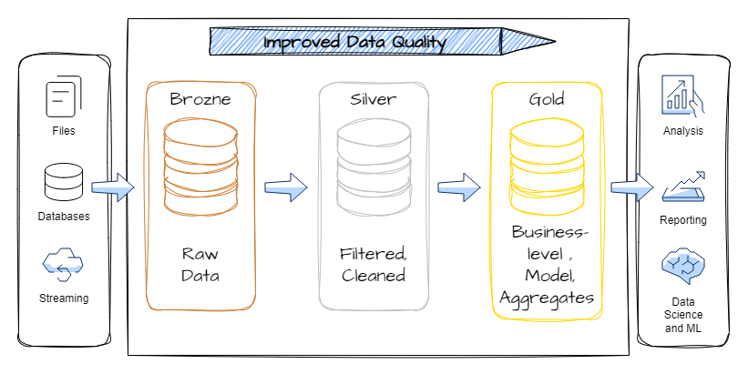
Medallion Architecture
Notes:
Medallion architecture consists of three distinct layers (or zones):
Bronze: Also known as the raw zone, this first layer stores source data in its original format. The data in this layer is typically append-only and immutable.
Silver: Also known as the enriched zone, this layer stores data sourced from the bronze layer. The raw data has been cleansed and standardized, and it's now structured as tables (rows and columns). It might also be integrated with other data to provide an enterprise view of all business entities, like customer, product, and others.
Gold: Also known as the curated zone, this final layer stores data sourced from the silver layer. The data is refined to meet specific downstream business and analytics requirements. Tables typically conform to star schema design, which supports the development of data models that are optimized for performance and usability.
Image from Exploring the Medallion Architecture in Microsoft Fabric | by Mariusz Kujawski | Medium
Other
The Medallion architecture defines three layers (bronze, silver, gold) where data can land and progress to serve different needs. The bronze (or raw) layer is typically used for initial ingestion of the data; data cleansing, validation, and transformation occurs in the silver layer – and additional modeling/aggregation takes place in a gold layer.

Slide 11
What is Real-Time Analytics?
Get insights as soon as the data is ingested for making better decisions quickly.
Handle large amounts of data
High velocity
Low response times
Notes:
Real-time analytics platforms like Azure Data Explorer and Fabric Real-Time Intelligence provide insights as soon as the data is ingested for making better decisions quickly. They handle large amounts of data with high velocity and low response times.

Slide 12
Architecture Forza Motorsport telemetry with Azure Data Explorer and Azure Event Hubs

Slide 13
Forza Motorsport telemetry setup
Notes:
Forza Motorsport – data out telemetry via UDP.
Edge compute – .NET app to receive/send telemetry.
Azure Event Hubs to receive data.
Azure Data Explorer – ingest, transform, analyze data
Visualization – ADX, Power BI / Fabric, other.

Slide 14
Our architecture
Notes:
Accessing the telemetry data. While I do not have access to an actual Formula 1 car, we can use gaming devices like the Xbox, PC, or PS which can emit the car’s telemetry data points (speed, lap position, tyre temp/wear/damage, etc) in near real-time during the live gameplay. As you can see for my demo, I’m using Forza Motorsport (Xbox/PC). You can also do this with the F1 games from EA.
Parsing the telemetry data. I have a .NET app which receives and parses the UDP data stream and then passes this onto Event Hubs. This application is running on the same network as my gaming device.
Ingesting telemetry data. ADX ingests data from Event Hubs connector and stores for analysis.
Bronze: Continuously ingest raw data to the raw landing table. Source can be streaming or batching ingestion. Retains the full, unprocessed history.
Silver: As data is ingested, it is processed by a table update policy and lands in the silver table. Update policies allow you to transform and enrich the data on a continuous basis. Data is then deduped as a materialized view.
Gold: Data is continuously aggregated as it arrives. Handles late arriving data. There can be multiple gold layer views.
Visualizing the results in near real-time with real-time dashboard.

Slide 15
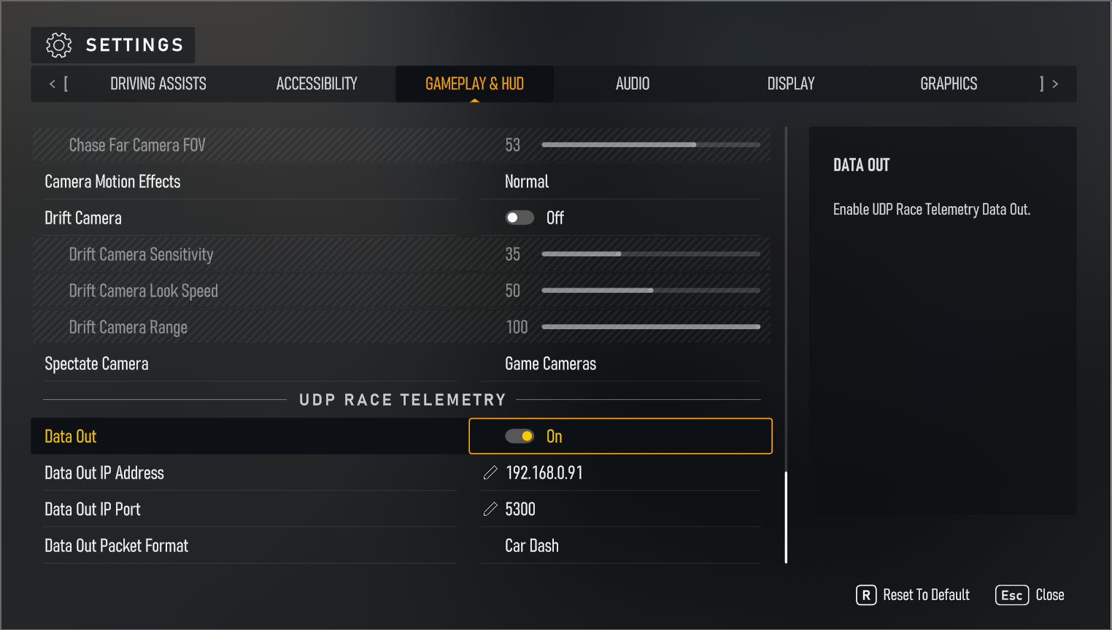
Configure telemetry
Notes:
Need to go into settings and enable Data Out and then set the IP, Port and Packet Format.

Slide 16
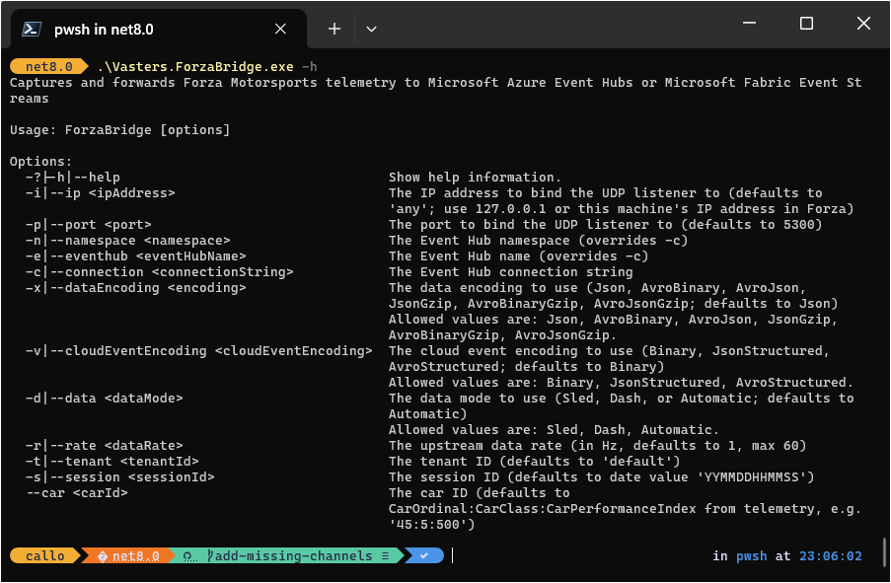
Edge compute
.NET 8 console app (forza-telemetry-bridge)
clemensv/forza-telemetry-bridge: Bridge from Forza Motorsports to Azure Event Hubs and Fabric Event Streams
Streams 71 channel events
.\Vasters.ForzaBridge.exe -c "Endpoint=sb://demo-cac-eventhub-evhns.servicebus.windows.net/;SharedAccessKeyName=ForzaBridge;SharedAccessKey=∗∗∗∗∗∗∗∗∗∗∗∗∗∗∗∗∗∗∗∗∗∗∗∗∗∗∗∗∗∗∗∗∗∗∗∗∗∗∗∗∗∗=;EntityPath=statistics-like-evh" -i 192.168.0.91 -d Dash -r 1
Notes:
-c: Connection string
-i: IP address
-d: The data mode to use (sled, dash, automatic)
-r: The upstream data rate (in Hz, defaults to 1, max 60)
Features
Customizable telemetry data capture over UDP.
Support for various data encodings (JSON, Avro) and compressions.
Direct integration with Azure Event Hubs.
Configurable data forwarding rates and session handling.
Real-time telemetry data processing and forwarding.

Slide 17
Event Hubs

Slide 18
Event design for high-throughput telemetry
Event Definition: Each event reflects an occurrence and is packaged with context, type, and timestamp.
High-Frequency Telemetry: Sensor readings in motor racing can reach 1000Hz+; most metrics captured at 100Hz.
Data Rate Challenge: Impractical to transfer/store each data point as its own event.
Bundling Solution: Events are bundled compactly, sharing common metadata to manage high data rates.
type: motorsport.channel.data
source: car71
subject: oilpressure
time: 2025-02-25T17:21:00.100000
{
"startTS": "2025-02-25T17:21:00.000000",
"endTS": "2025-02-25T17:21:00.100000",
"rate": 1000
"values": [4.12225523,4.122321882, 4.12227722...]
}
// 100 items for 0.1s

Slide 19
Data Explorer

Slide 20
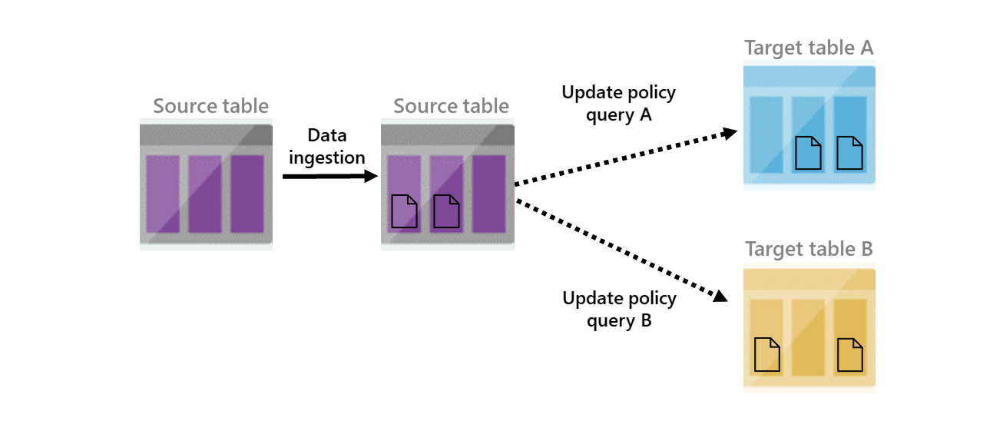
Update policy
Inner ETL / Trigger
Works with medallion architecture
Source table is scoped to newly ingested data
Scenarios
Filter out data, deduplication
Created calculated columns, changing schema, joining static dimension data
Different retention policies for subset of the data

Slide 21
Demo Event Hub and Data Explorer setup

Slide 22
Data Explorer

Slide 23
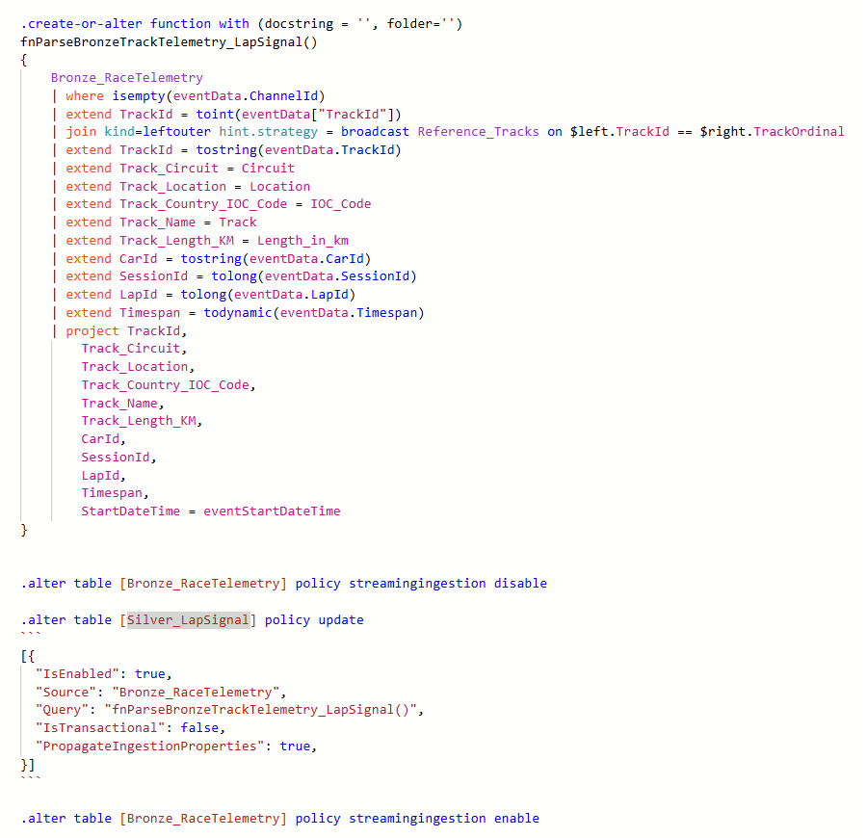
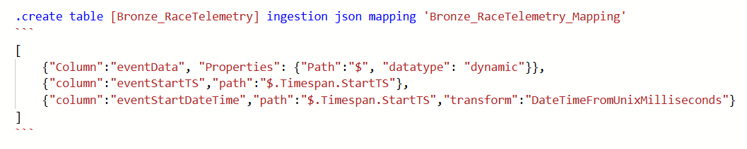
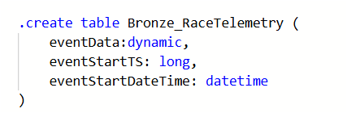
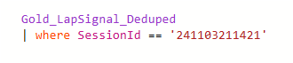
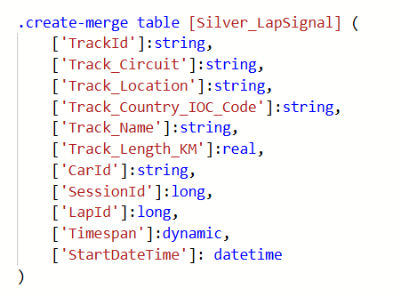
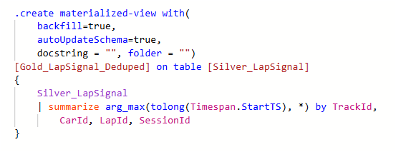
Data Flow
1
JSON
Ingest
2
3
Copy and transform
6
5
4
Query
Project / Dedup
Store

Slide 24
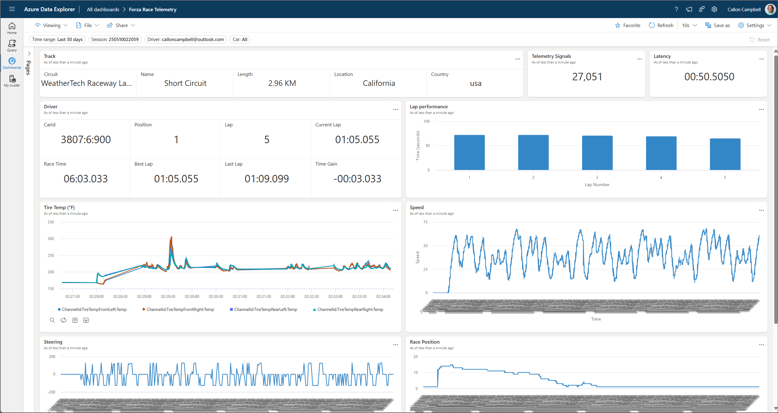
Real-time Dashboard

Slide 25
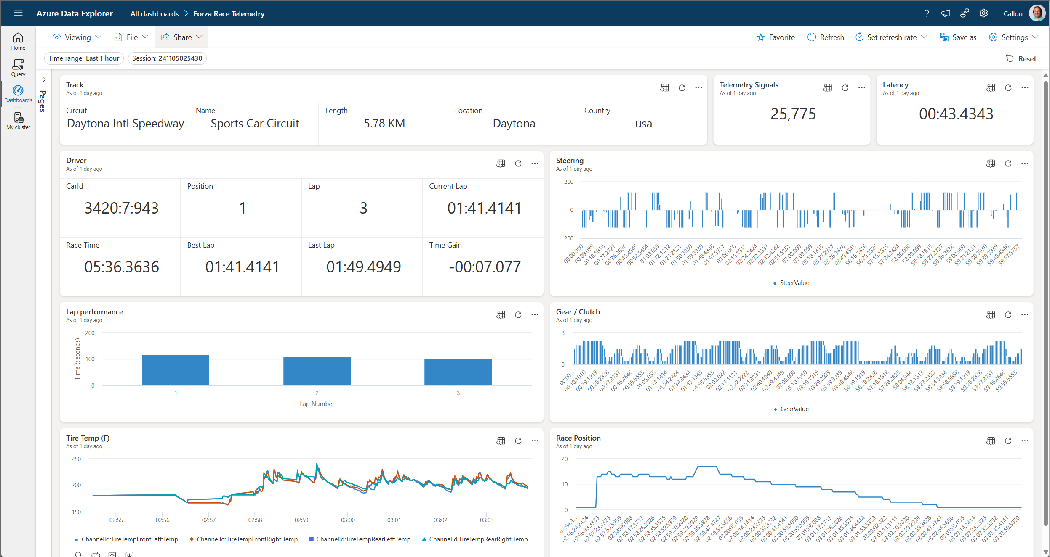
Real-time Dashboard

Slide 26
Demo Racing time

Slide 27
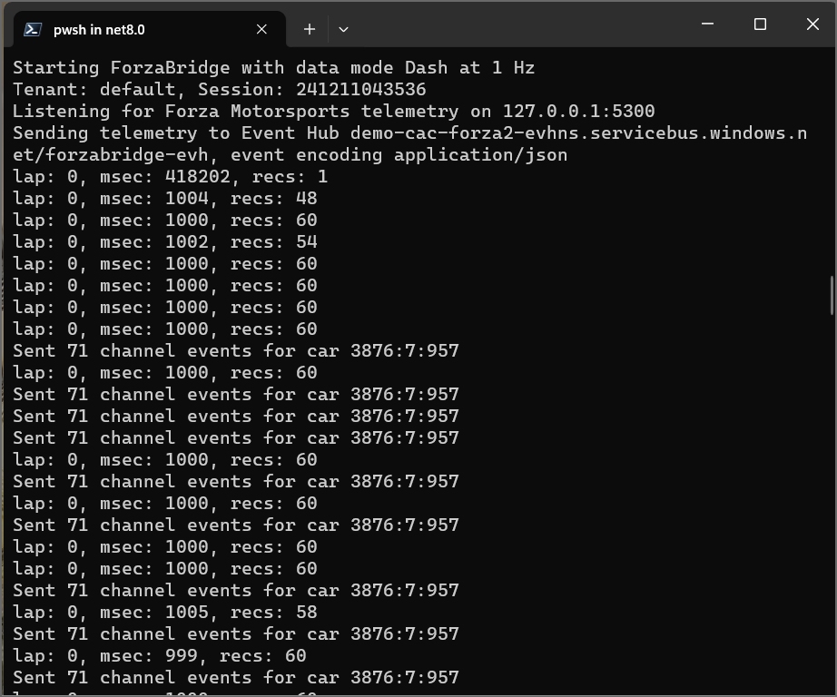

Slide 28
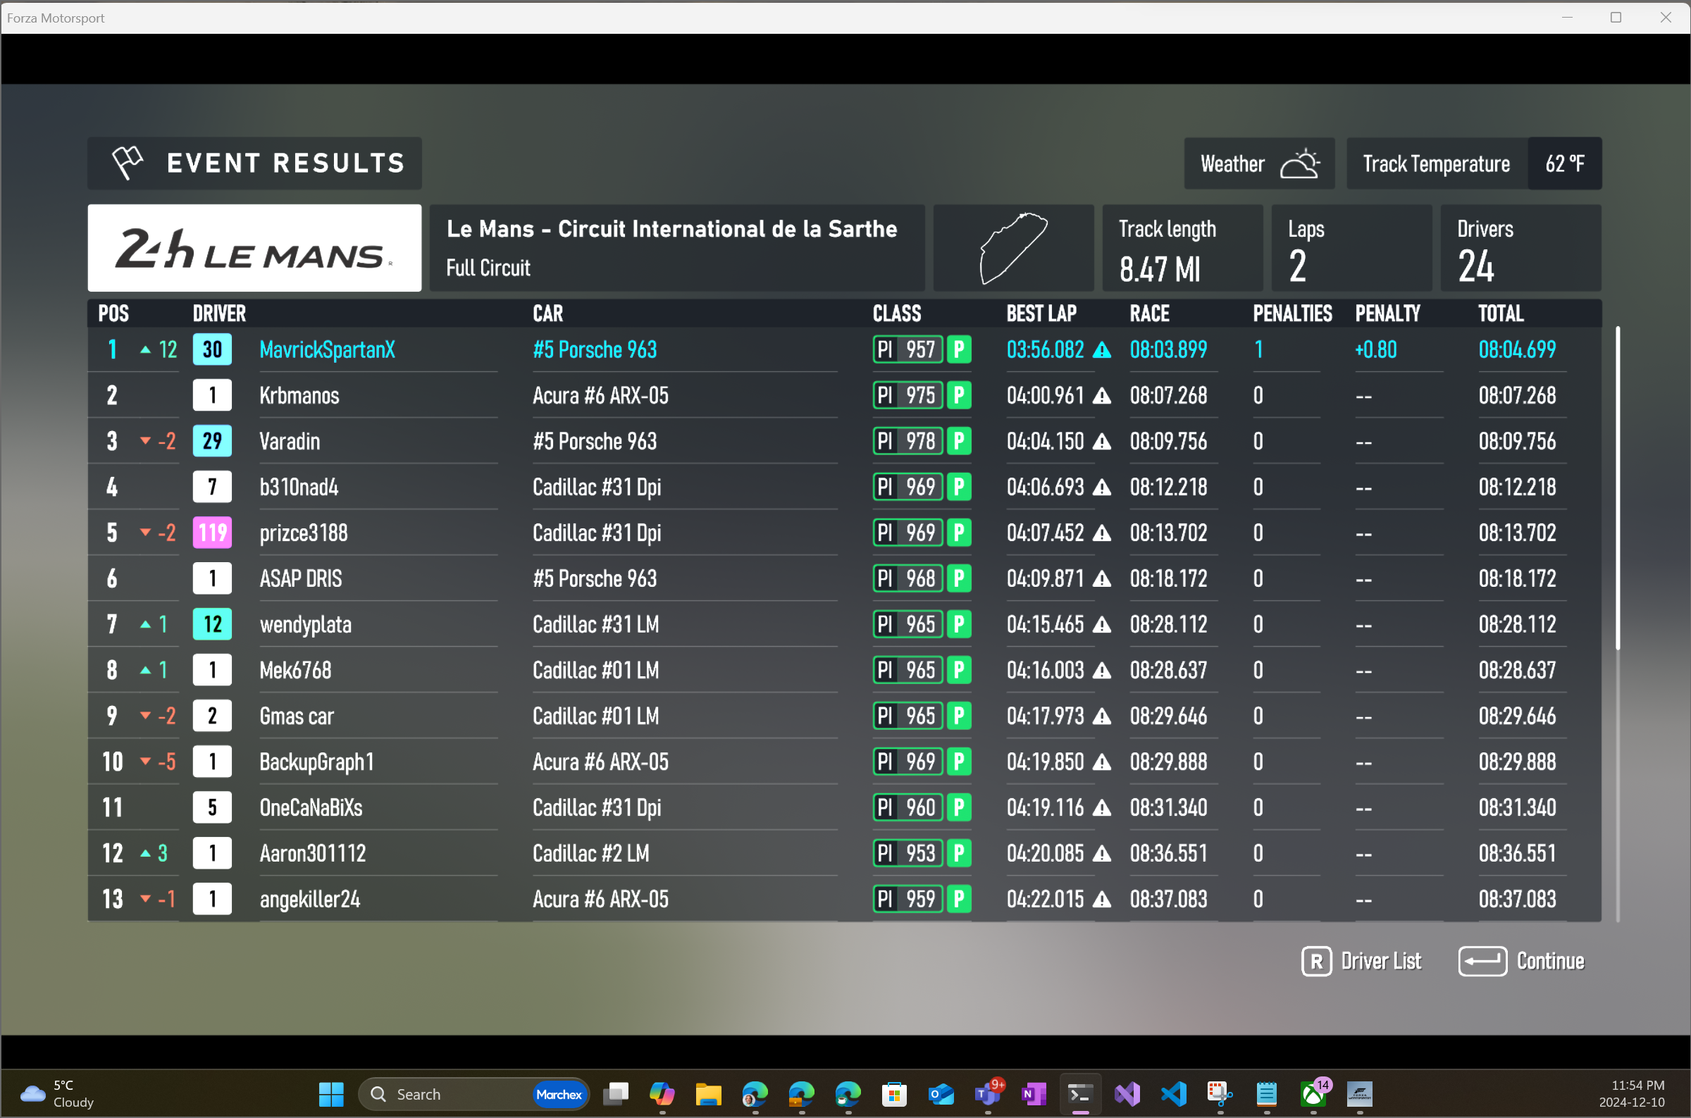

Slide 29
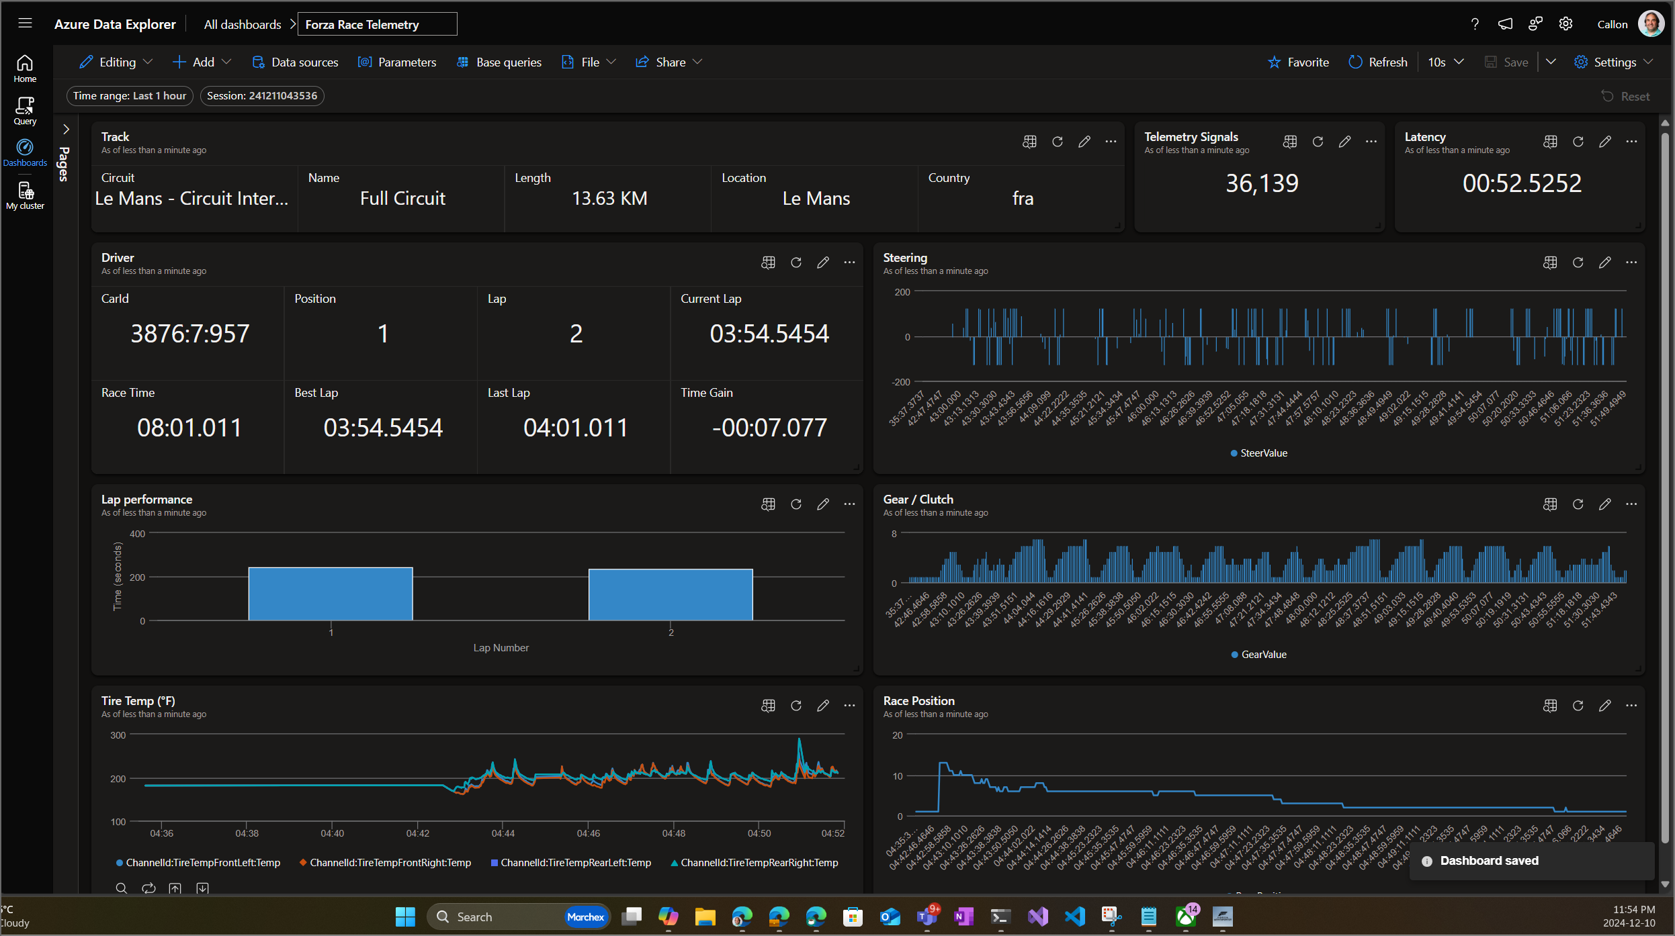

Slide 30
Wrap-up
Real-time medallion architecture for Formula 1 telemetry data using Azure Data Explorer.
How to ingest, process, and visualize high-velocity data streams.
Derive real-time insights and performance analysis.
All of this can be done in Microsoft Fabric Real-Time Intelligence.

Slide 31
References
Forza Motorsport Telemetry / Demo App
Forza Motorsport "Data Out" Documentation – Forza Support
clemensv/forza-telemetry-bridge: Bridge from Forza Motorsports to Azure Event Hubs and Fabric Event Streams
https://github.com/calloncampbell/forza-telemetry-bridge
bluemanos/forza-motorsport-car-track-ordinal: Forza Motorsport cars and tracks ordinal data
Azure Data Explorer
https://aka.ms/adx.docs
https://aka.ms/kustofree
https://aka.ms/adx.try
https://aka.ms/adx.lab
Fabric Real-Time Intelligence
Implement medallion lakehouse architecture in Fabric

Slide 32
Thank you
LinkedIn: @calloncampbell
GitHub: @calloncampbell
X: @Flying_Maverick
https://TheFlyingMaverick.com
Callon Campbell
Azure Architect Microsoft MVP | Azure

Slide 34

Batching vs streaming ingestion
Batching
Optimized for high ingestion throughput
Preferred method and most performant
Data is batched according to properties
Set ingestion batching policy on databases or tables
Default max batching value is 5 minutes, 1000 items or total of 1 GB
4 GB data size limit for a batch ingestion command
Streaming
Ongoing data ingestion from a streaming source
Near real-time latency for small sets of data per table
Initially ingested to row store
Then moved to column store extents
Steaming can be done using ADX client library or supported pipelines
NOTE: The recommendation is to ingest files between 100 MB and 1 GB.
Notes:
Data Explorer supports two types of ingestion: Batching and Streaming.
https://docs.microsoft.com/en-us/azure/data-explorer/ingest-data-overview#batching-vs-streaming-ingestion
Small batches ingested get merged and optimized behind the scenes.

Slide 35
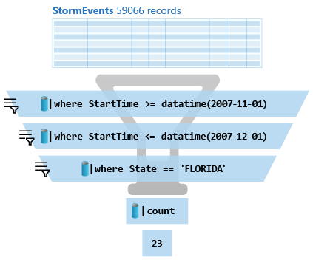
Kusto
A Kusto query is a read-only request to process data and return results.
Has one or more query statements and returns data in a tabular or graph format.
Statements are sequenced by a pipe (|). Data flows, or is piped, from one operator to the next.
The data is filtered/manipulated at each step and then fed into the following step. It's like a funnel, where you start out with an entire data table.
Each time the data passes through another operator, it's filtered, rearranged, or summarized.
Notes:
Kusto or KQL is the language used to query read-only requests
Very fast
Ideal for time-series data
Built-in Functions

Slide 36
Azure Data Explorer References
https://aka.ms/adx.docs
https://aka.ms/kustofree
https://aka.ms/adx.try
https://aka.ms/adx.lab
https://aka.ms/adx.cost
https://aka.ms/adx.architectures
https://github.com/Azure/ADX-in-a-day (hands on lab)

